Slide 2
Incubation Time vs Staining Intensity
3 states
12hr primary (at 4C) + 2 hour secondary
2 hour primary (RT) + 2 hour secondary
1 hour primary (RT) + 1 hour secondary

Slide 3
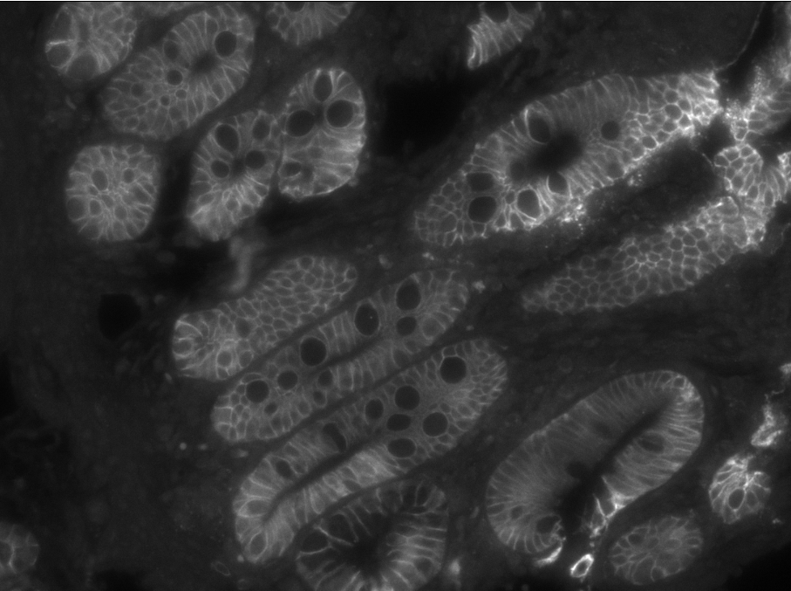
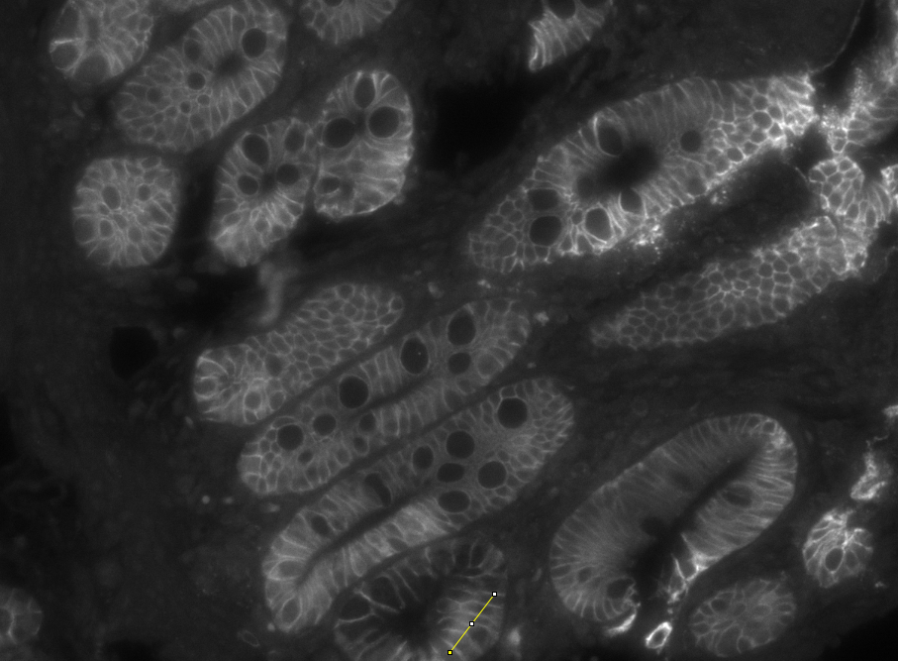
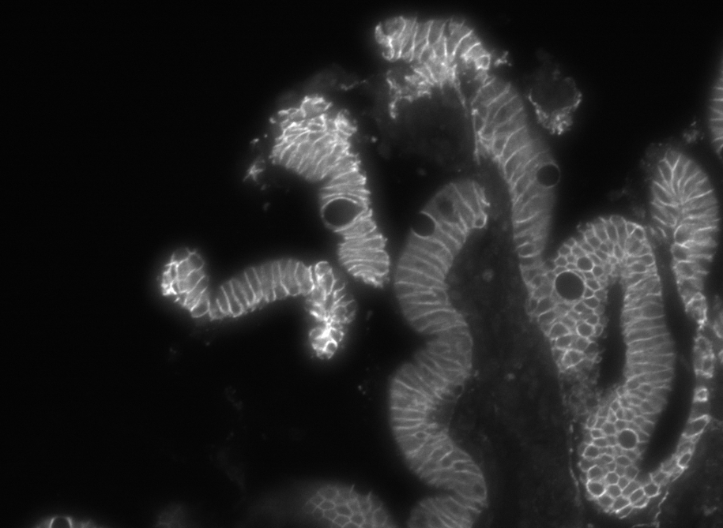
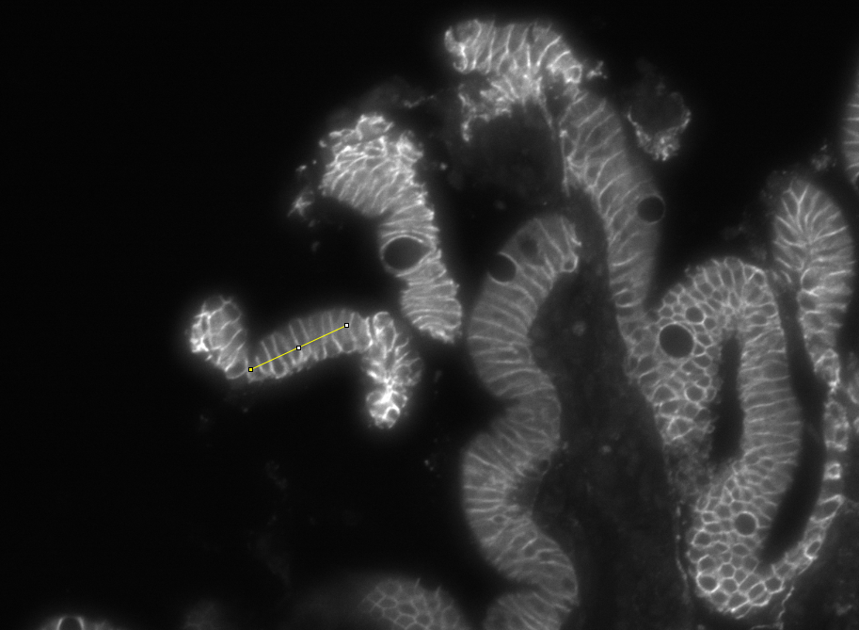
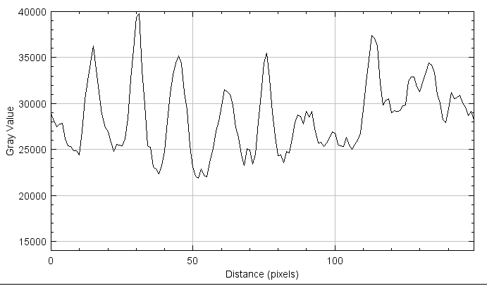
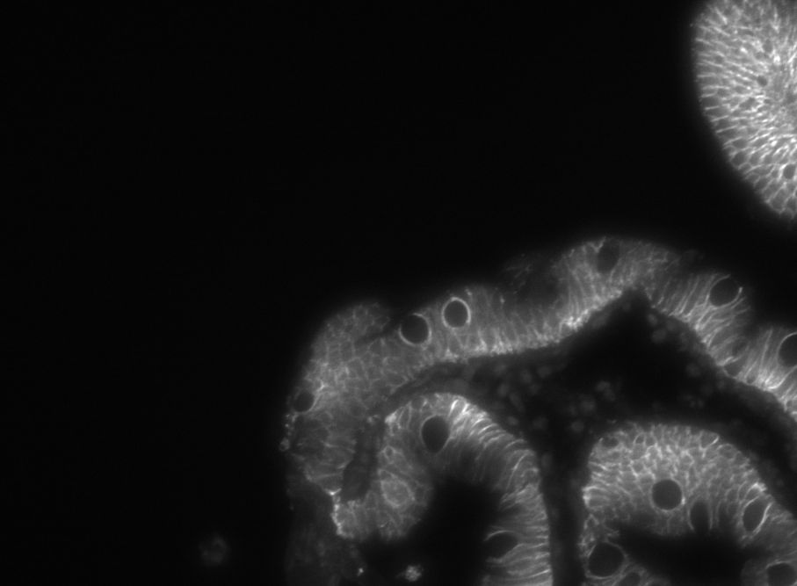
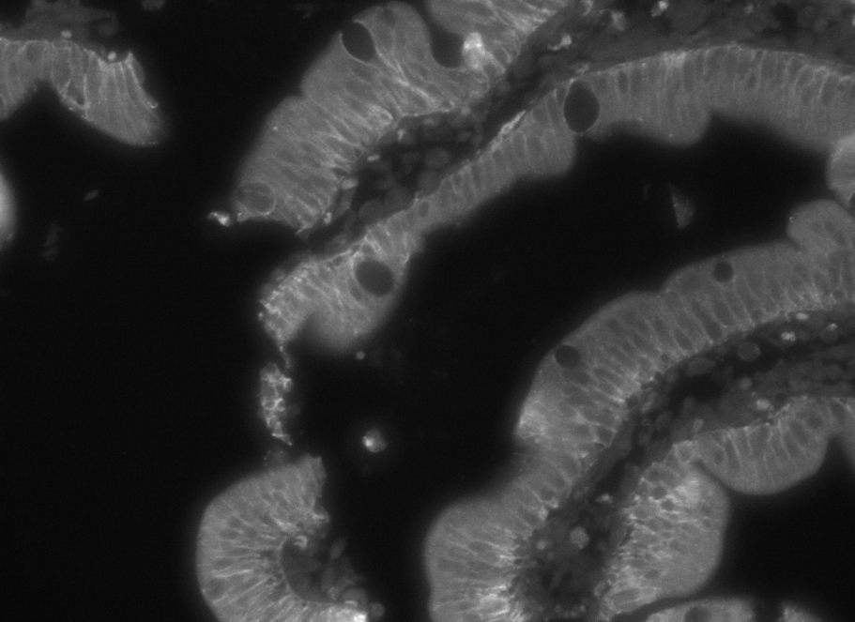
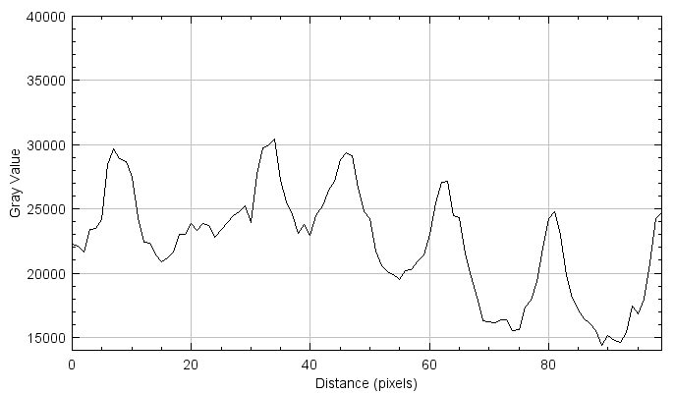
Overnight Incubation (approx. 12hrs)
2hr RT secondary Inc
ECAD (A488)
1hr Incubation 1hr RT secondary Inc
210618_111250
S_20_0008109

Slide 4
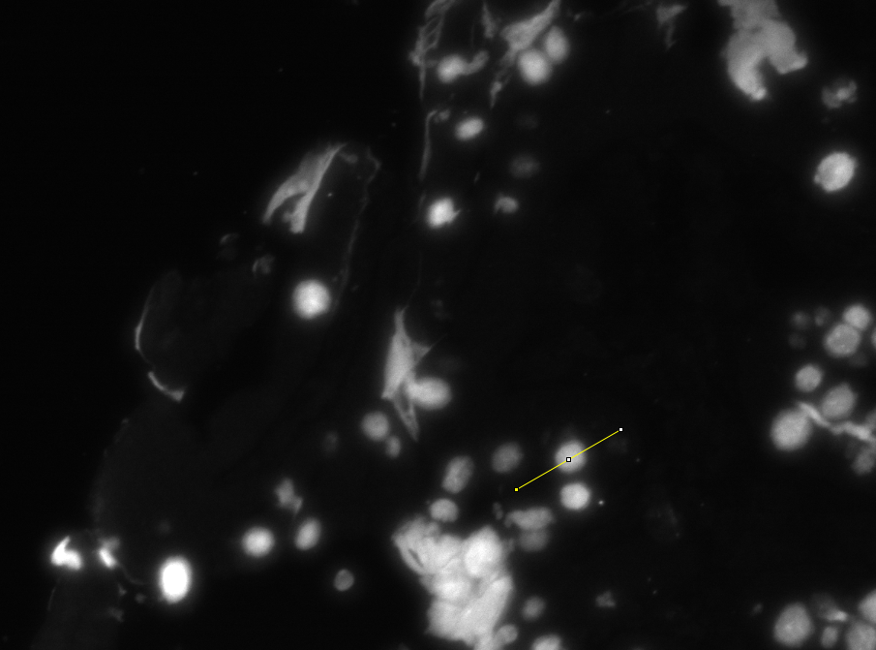
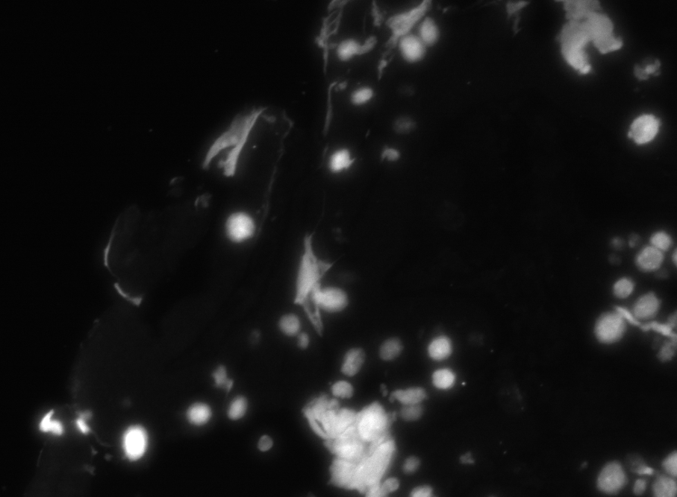
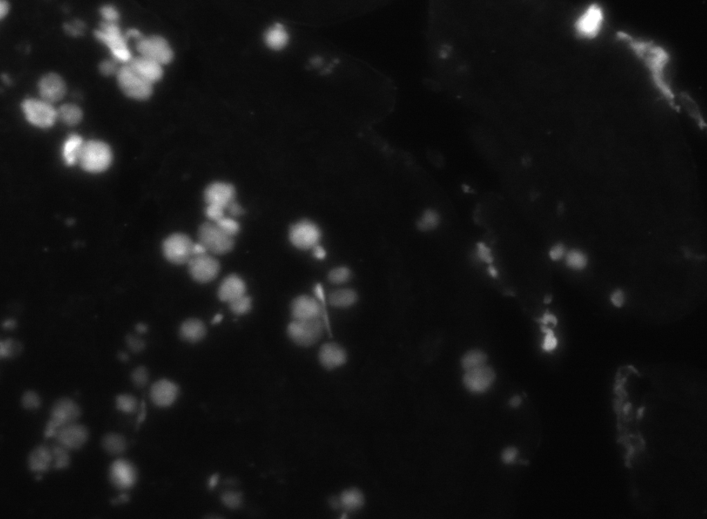
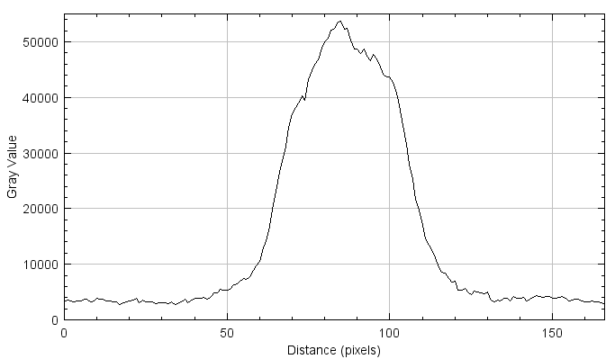
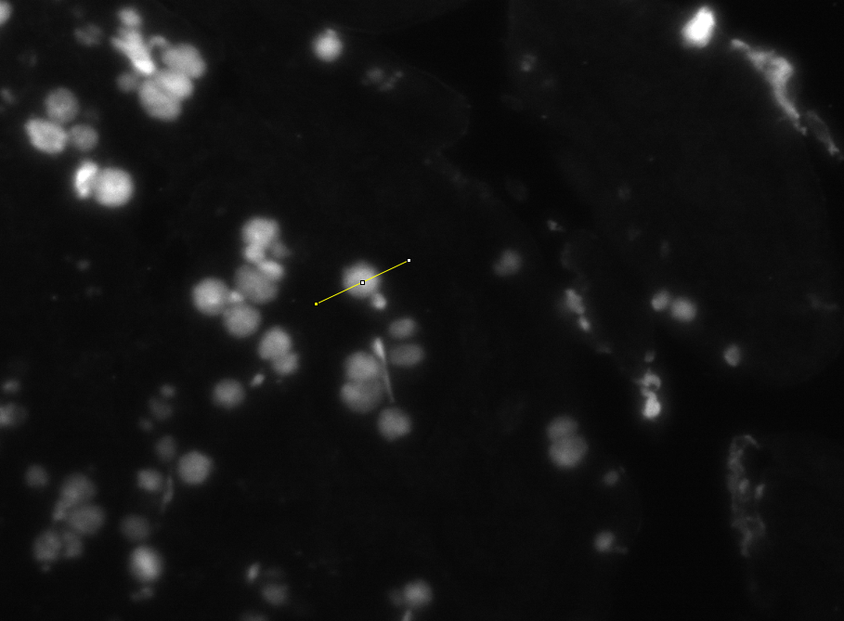
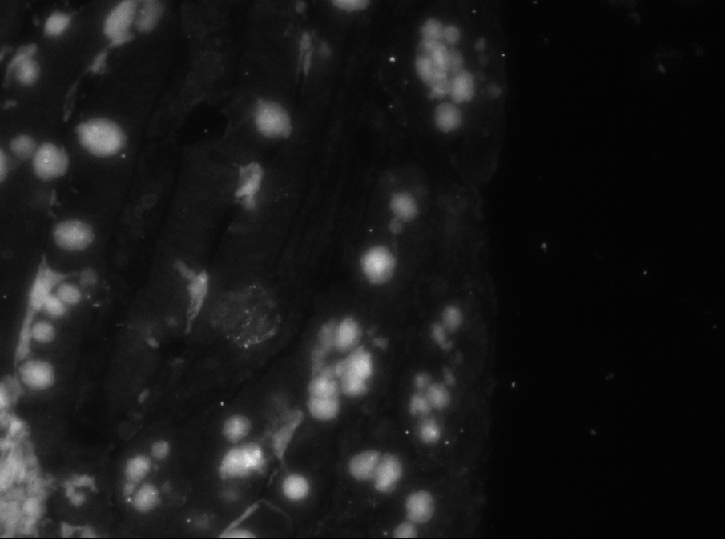
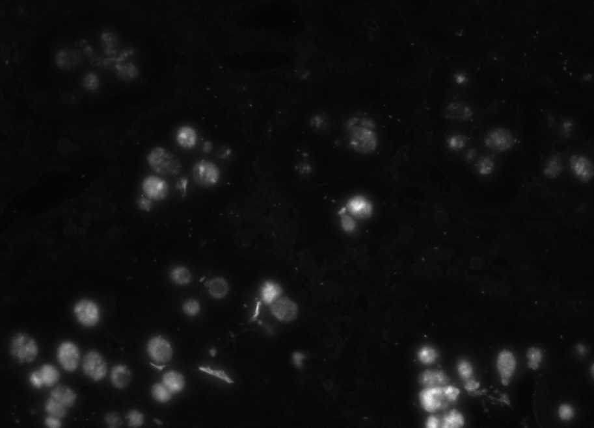
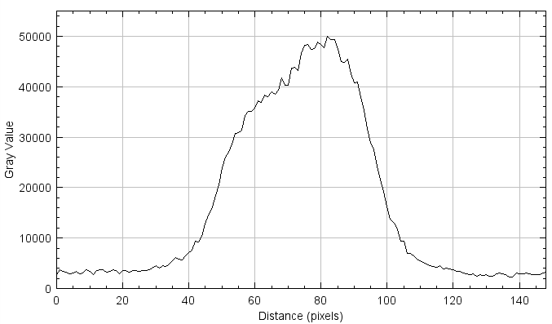
Overnight Incubation (approx. 12hrs)
2hr RT secondary Inc
1hr Incubation 1hr RT secondary Inc
210618_111250
S_20_0008109

Slide 5
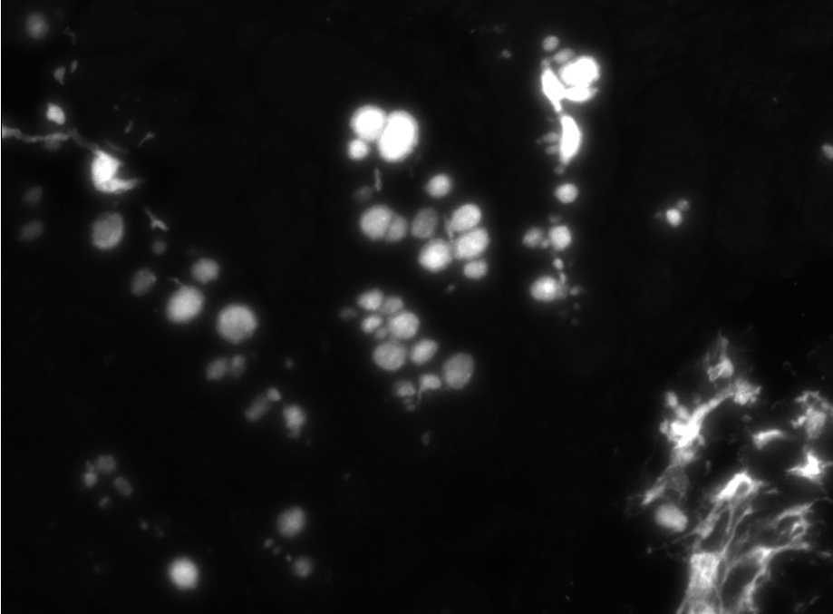

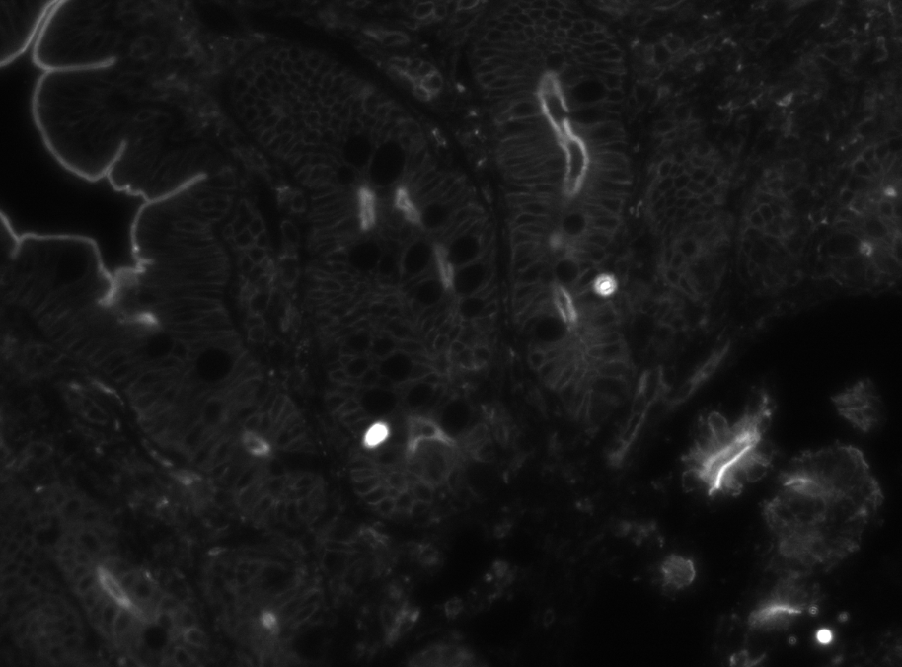

A647
Stained
Bleached
210618_111250
Muc-2
Gamma Actin

Slide 6
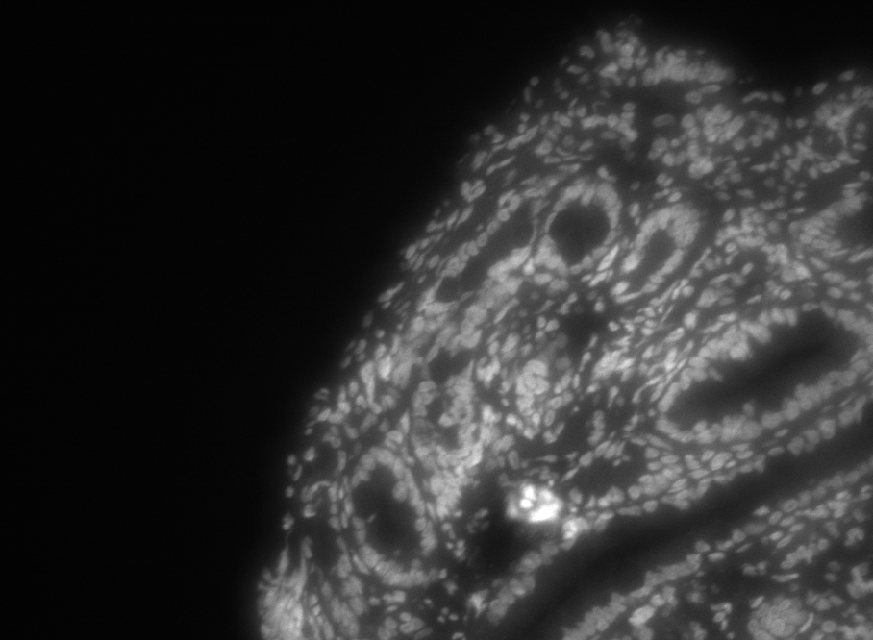
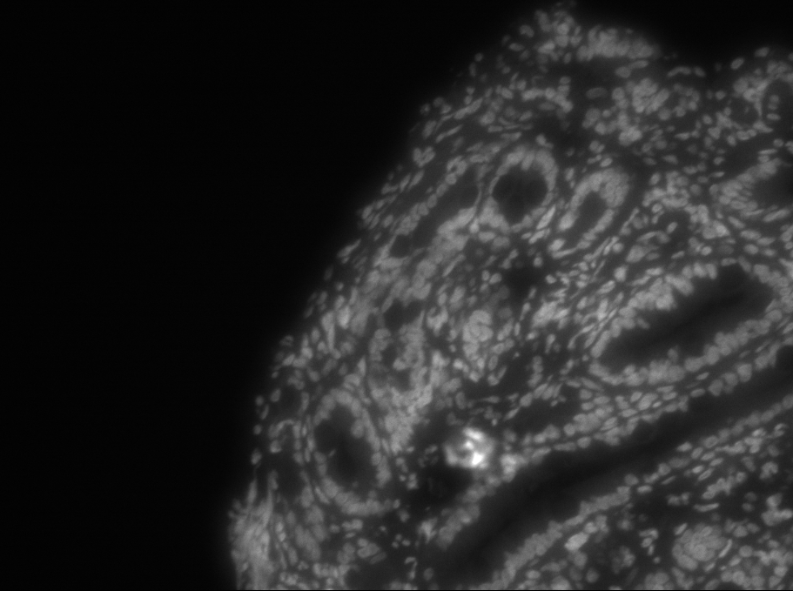
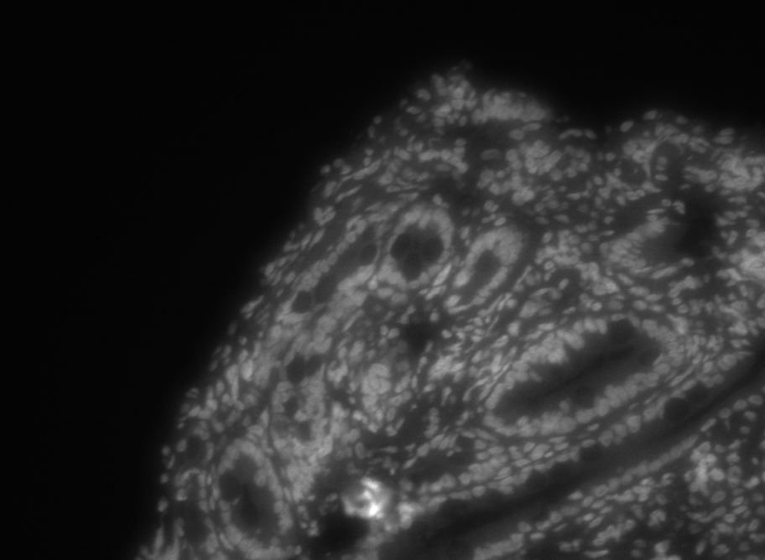
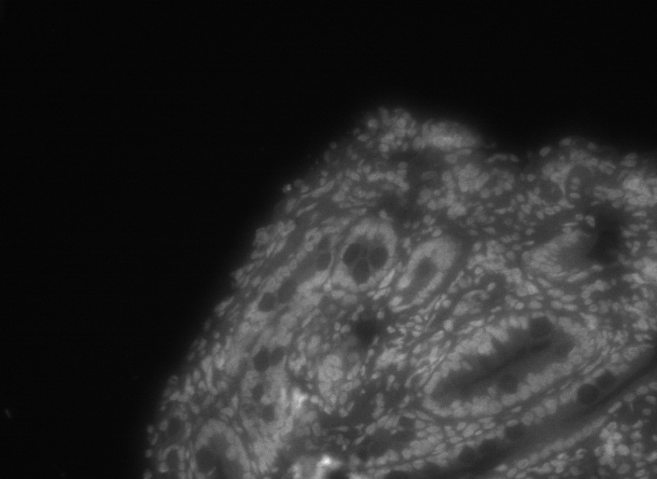
DAPI
Stained
Bleached
S_20_0009810
DAPI
DAPI

Slide 7
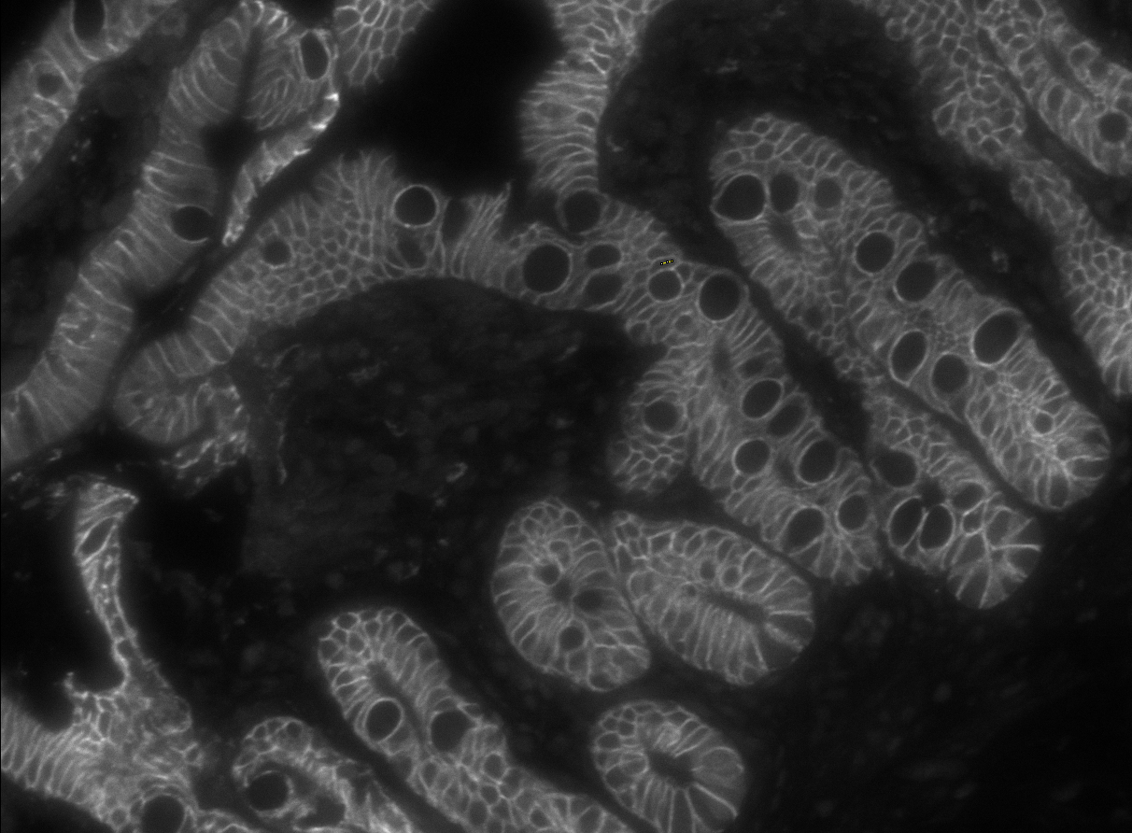
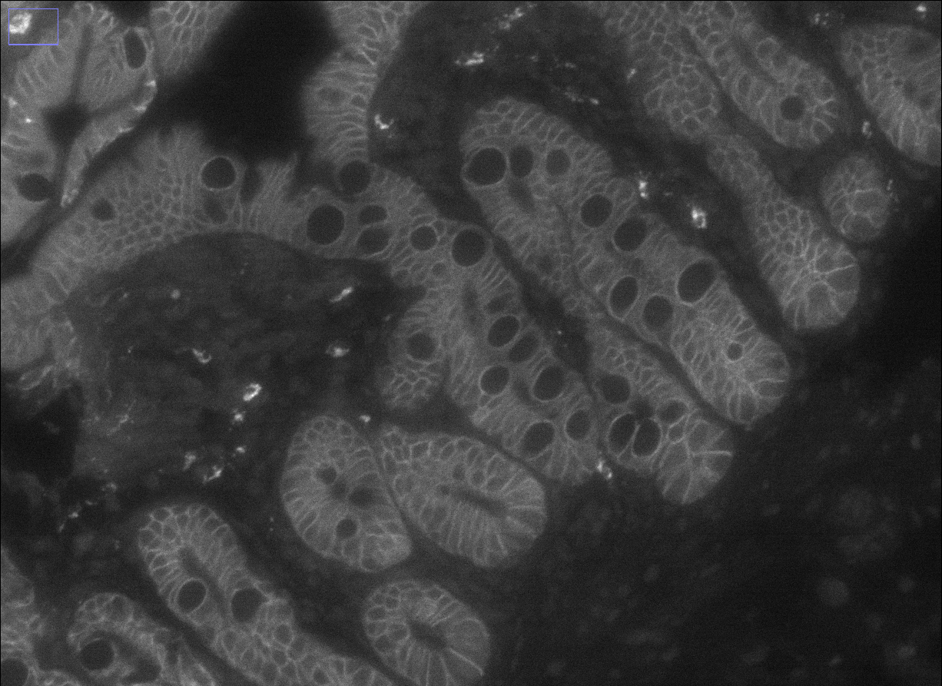
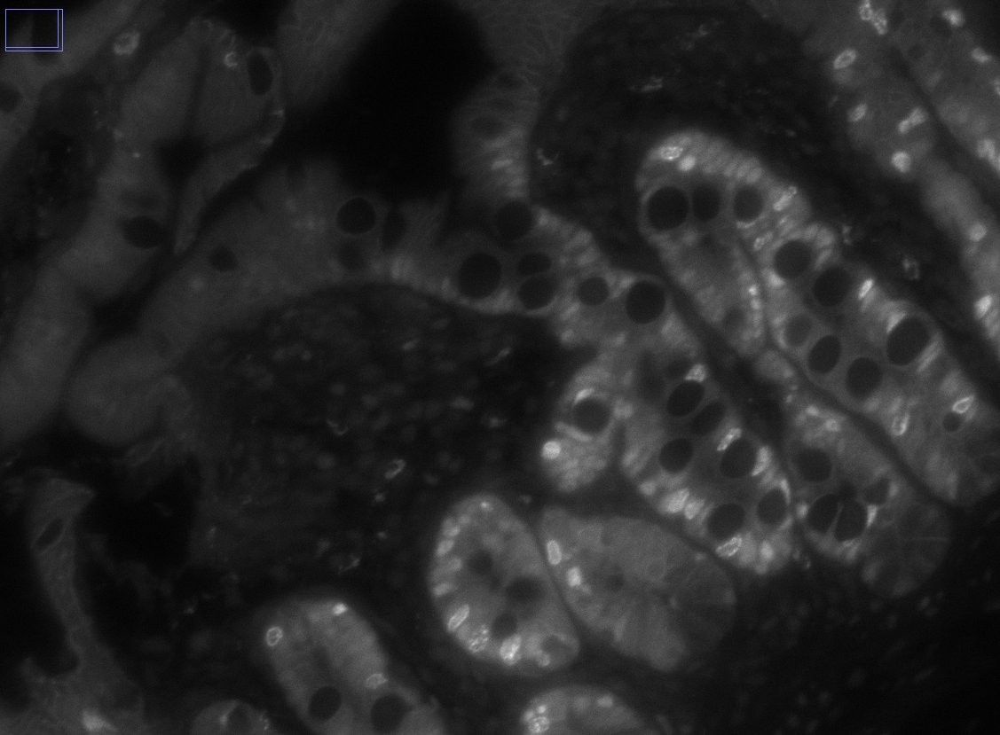
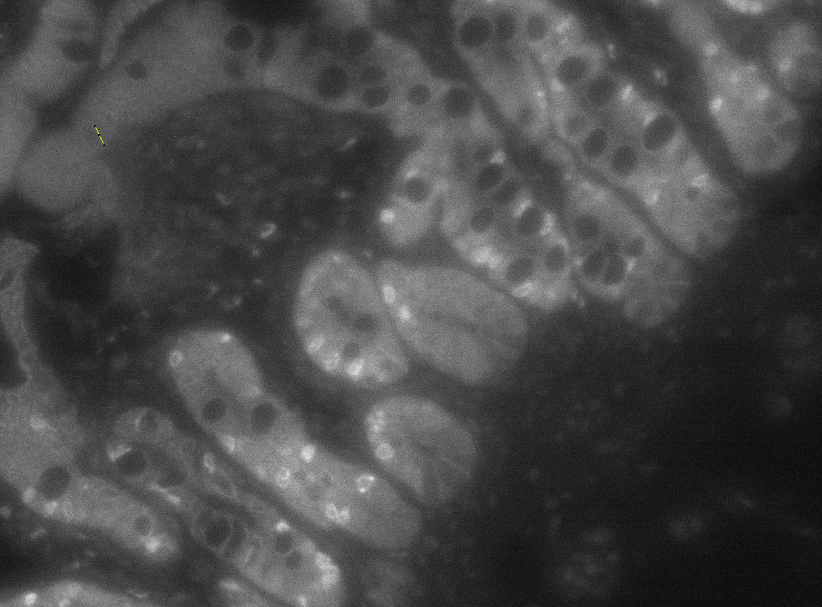
A488
Stained
Bleached
210618_111250
E-Cad
PCNA

Slide 8
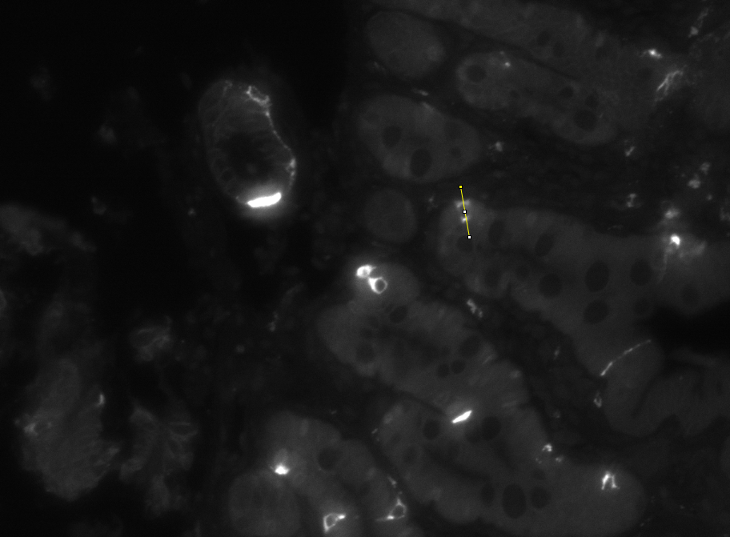
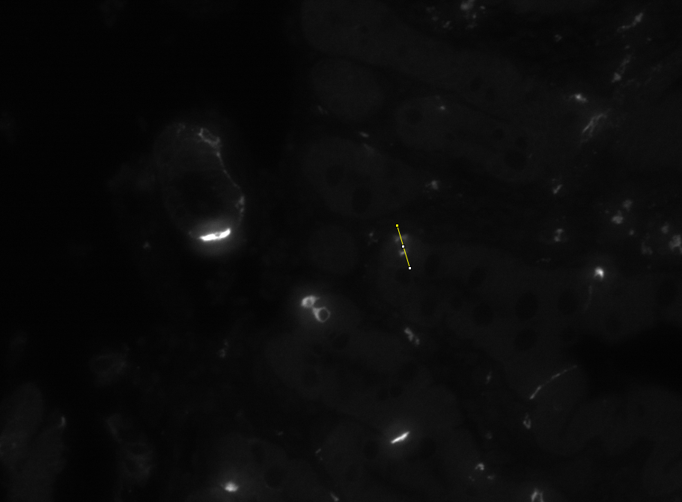
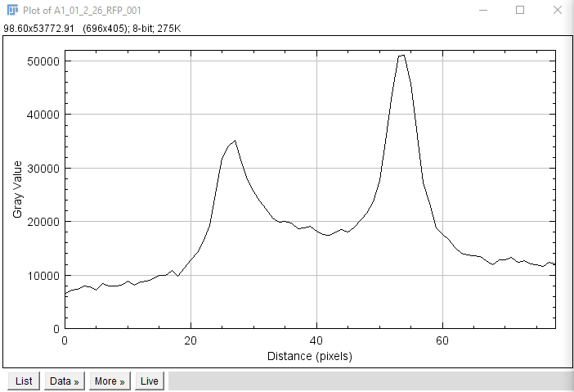
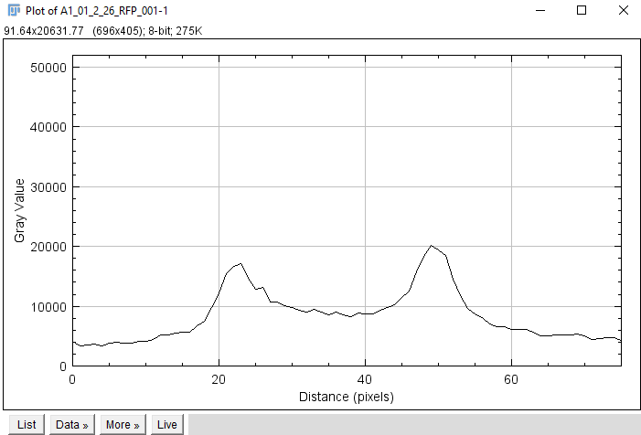
A594
Stained
Bleached
210618_111250
Chromogranin-A

Slide 9
NanoSite ABS Results
*Note no 60 min time point for A647 and no 12 min for A594

Slide 10
Bleach Cycle 1
Bleach Cycle 2

Slide 11
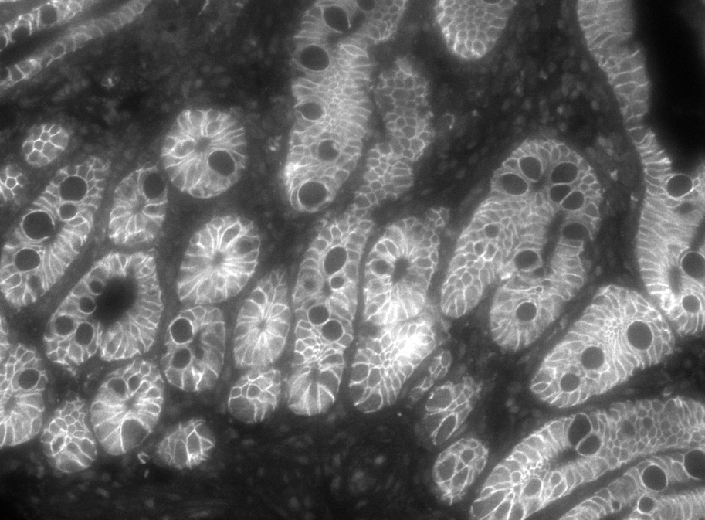
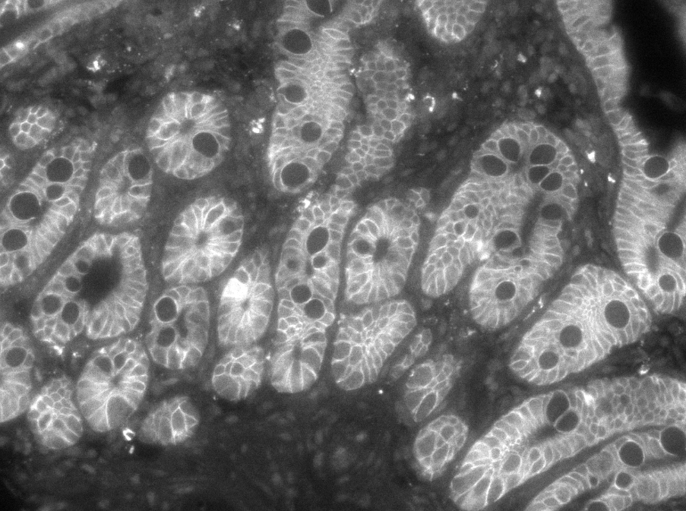
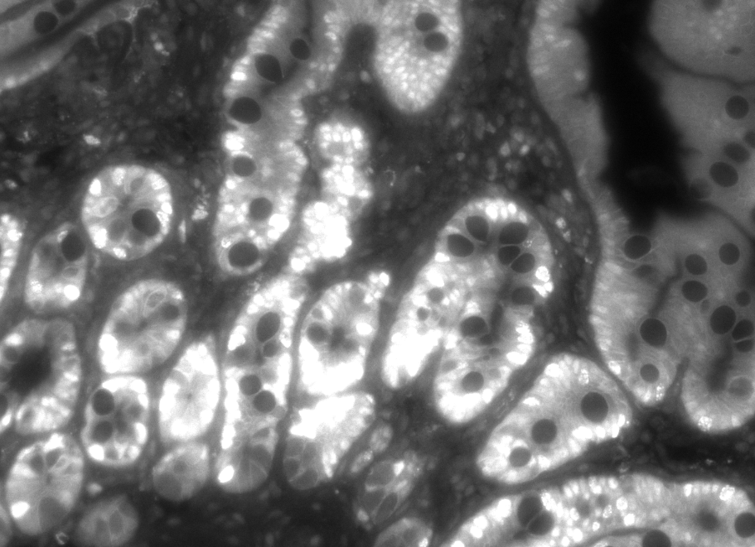
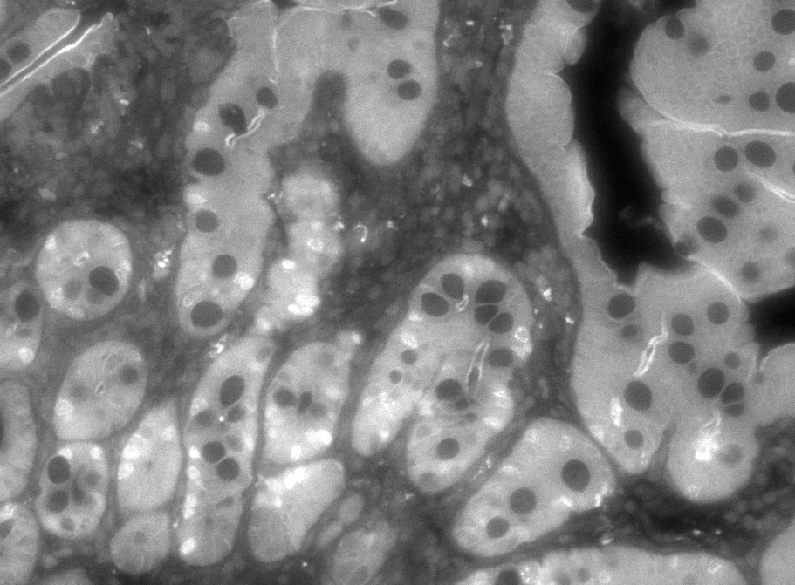
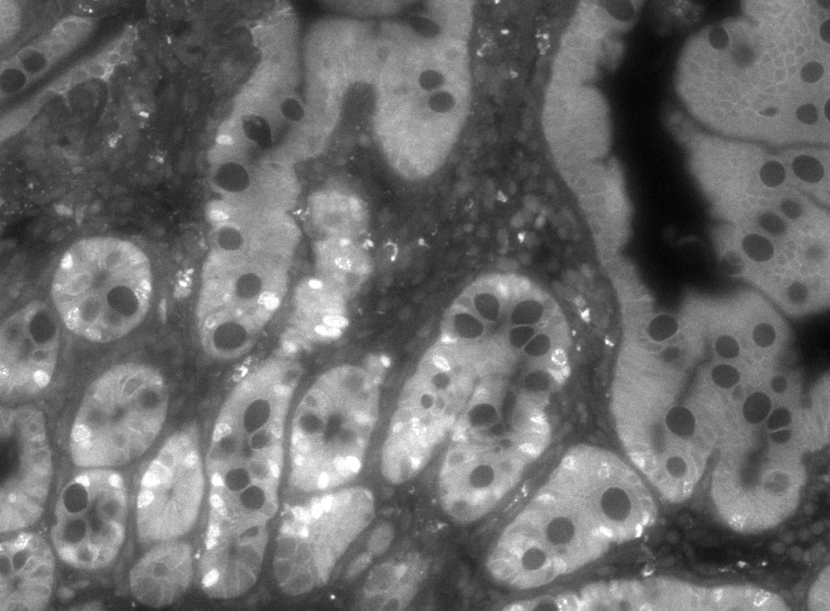
Imaging Round Drift on Biotek

Slide 12
Summary
A488 needs bleached more thoroughly
Incubation times can be pushed lower
A594 is probably a dye that has no good CyCIF use, but showed more potential than previous data suggested
Biotek + human error is right on the fringe of being good enough for CyCIF cycle alignment

Slide 13
Detailed Kinetic Work and The Future of CyCIF Imaging at BCH
Detailed fluorescence emission experiments. (previous publications focused on absorbance measurements). Goal is to measure bleaching half time by varying the following parameters in the bleaching solution:
pH (7.5-11)
H2O2 concentration (0.1% - 30%)
Test the degree to which added light accelerates the bleaching rate

Slide 14
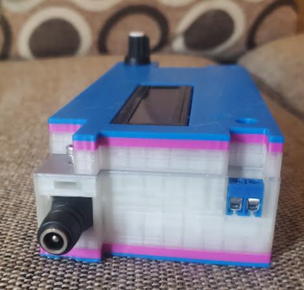
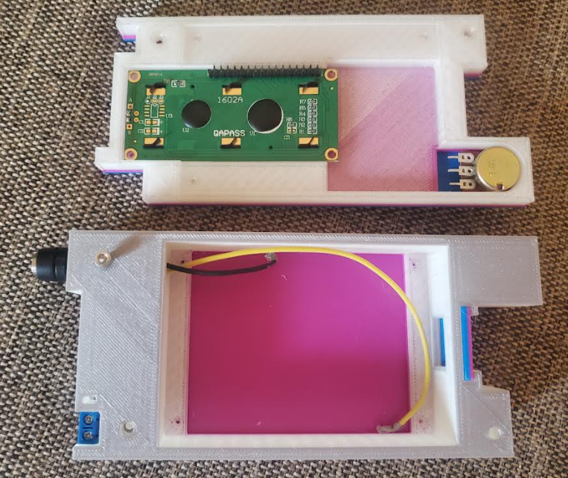
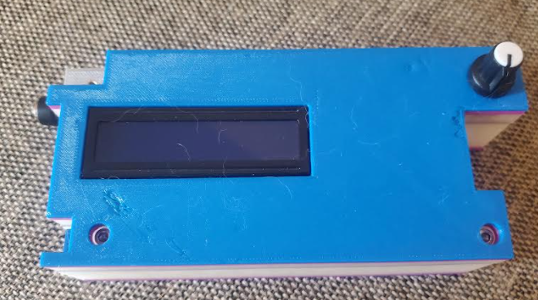
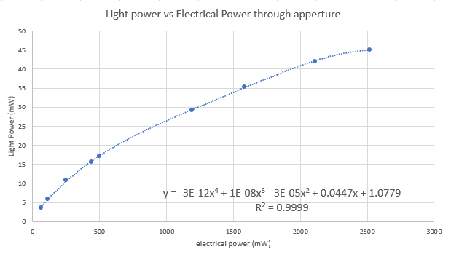
Light Bleaching (Ice Cream Sandwich)
This experiment involves pure light to quantify the acceleration of the bleaching process via an LED shining on a cuvette of Alexa 488 solution
Normal LED driver wont do. Needs to be modulatable, constant current, real time electrical power readings
The “ice cream sandwich” is a custom built arduino based device to do this. Its all self contained with a barrel plug port and ports for the LED power lines.

Slide 15
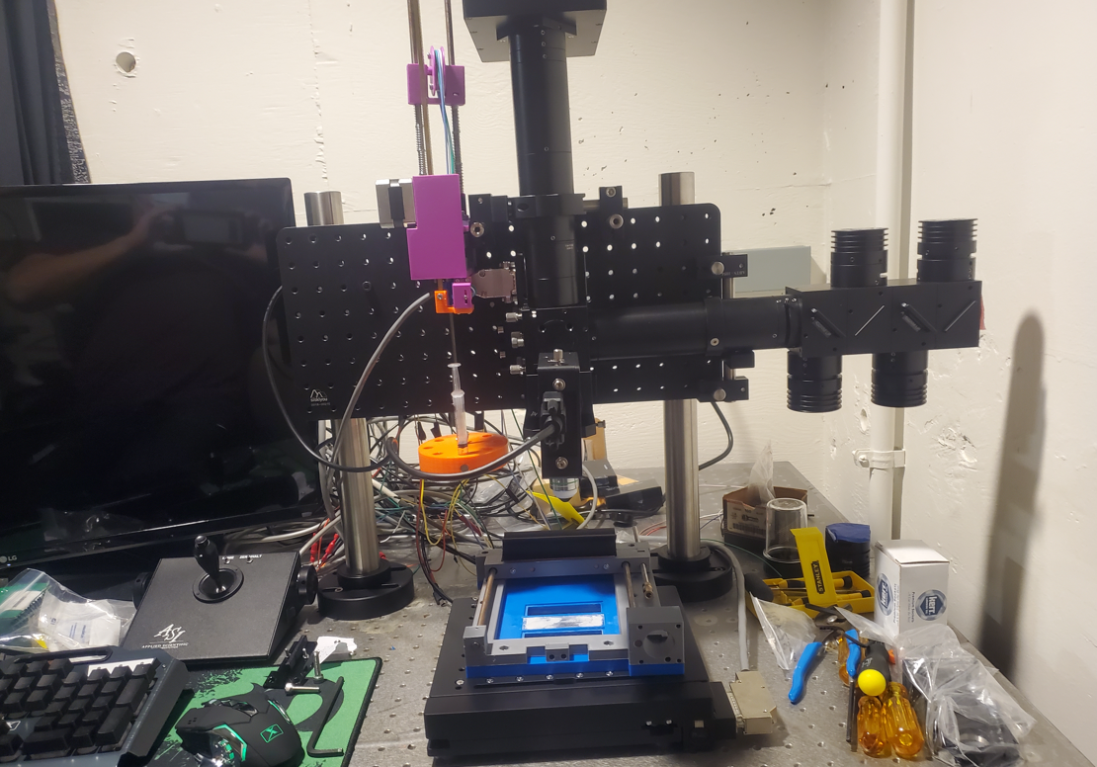
Auto CyCIF Microscope

